Slide 1



Analysis on Housing Price indicators
Sidharth Sreekumar

Slide 2

Overview of Home Sales Data
Purpose: To analyze historical home sales data for predicting future sale prices
Data Frame: Sales data from 2006 to 2010
Number of Observations: 1460 homes
Number of Variables: 81, including features and the target variable

Slide 3
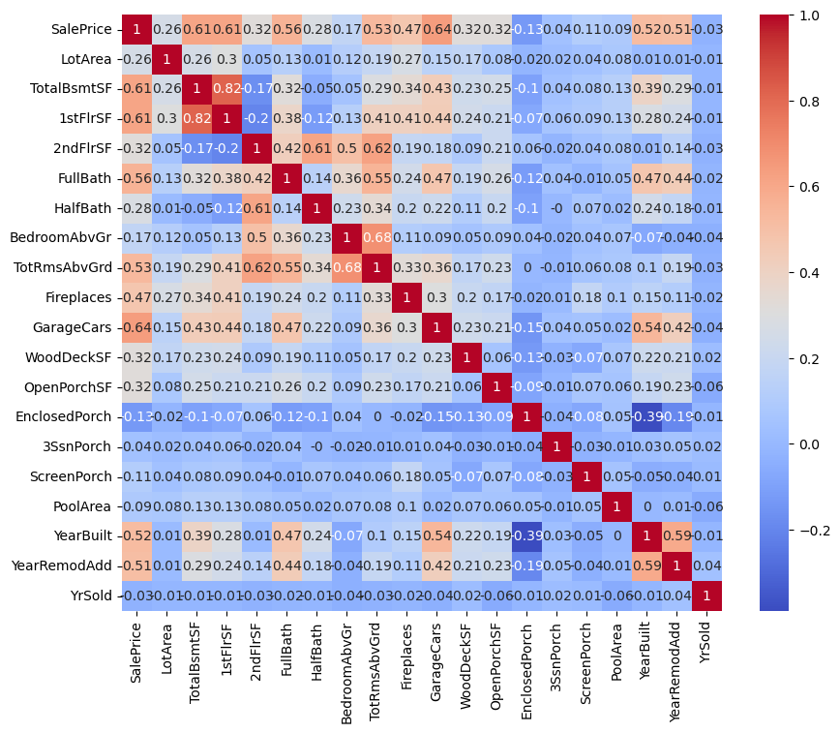
Understanding the Predictors
Response Variable =SalesPrice
Predictors with a Strong correlation:
GarageCars
TotalBsmtSF
1stFlrSF
FullBath
Notes:
The heatmap shows the correlation between two variables, ranging from -1 to 1, where colors closer to red indicate a stronger positive correlation and colors closer to blue indicate a stronger negative correlation. The response variable in our analysis, SalePrice, is the primary focus as it represents the property value we aim to predict. The heatmap clearly shows GarageCars, TotalBsmtSF, 1stFlrSF, and FullBath exhibit strong positive correlations, suggesting that as these features increase or improve the sale price of the home. Thogh in our final model may not have all of these they should have a majority of the predictors listed. This visual representation helps us identify key features that significantly impact home values, providing insights for better descions in real estate investments. By focusing on these predictors, we can better understand how various property characteristics influence market prices.

Slide 4
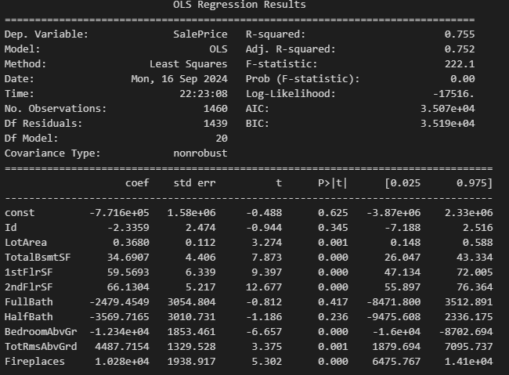
Initial Model
Higher R squared is preferred
Many variables with a P- value about 0.05
*Does not show all predictors. Image is presented to show the poor relationship of the variables.
Notes:
The initial regression model seems problematic due to several issues. Firstly, the extremely high coefficients and standard errors for variables which indicate instability and possible overfitting. This basically means its predictions can change a lot with slight differences in the data; it's not consistent. Such large values typically suggest underlying data issues such as multicollinearity or scaling problems. This is when too many variables are highly correlated with each other. Secondly, several predictors display high p-values, implying they are not significantly contributing to the model, which questions the utility of including them.

Slide 5
Steps to a Final Model
Run
Run a Stepwise selection
Remove
Remove High P value predictors
Apply
Apply a log function to decrease Multicollinearity
Notes:
Start with a stepwise selection to ensure each feature included significantly impacts home sale prices. Stepwise selection process adds and removes predictors based on their statistical significance and contribution to home sale prices. This ensures that every feature included in the model has a justified reason for its presence We then streamline the model by removing variables with high P-values that show weak relationships with sale prices. To tackle multicollinearity, we apply logarithmic transformations, enhancing the model's accuracy by isolating the unique influence of each predictor. This approach results in a reliable model, providing clear insights for informed real estate investment decisions.

Slide 6
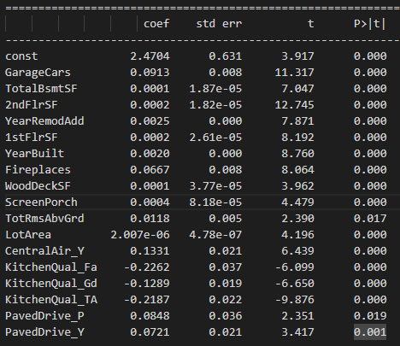
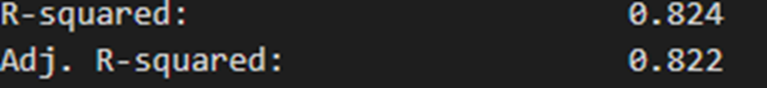
Final Model Output
R Squared above 0.6
P> |t| below 0.05
Notes:
The figures in the 'coef' column show how much each feature adds or subtracts from the value of a house. For example, each additional car that can fit in a garage increases the home's sale price by about 0.0913 units, indicating that garage size is quite valuable.
Our model explains 82.4% of the variations in house prices, which is a strong indicator of its reliability. Essentially, it means that we can confidently predict over 82% of the reasons behind different house prices based on the features we've included here.
Particularly important are the 'P>|t|' values—these tell us how statistically significant these features are. Values below 0.05, like for the number of garages, mean we are over 95% confident that these features really do impact the house prices as predicted. This level of detail helps us focus on what’s truly important for house valuation, enabling smarter investment decisions.

Slide 7
Significant Predictors from our Model
GarageCars
TotalBsmtSF
2ndFlrSF
YearRemodAdd
1stFlrSF
YearBuilt
Fireplaces
WoodDeckSF
ScreenPorch
TotRmsAbvGrd
LotArea
CentralAir_Y
KitchenQual
PavedDrive
Notes:
We are able to highlight the key factors that our regression model has identified as significant predictors of housing prices. Each box represents a variable that influences the price, according to our analysis. This model allows us to quantify just how much each of these features might add to or subtract from a property’s market value, providing us with insights that can guide investment decisions. By understanding these relationships, investors can better identify properties that offer the most value or have the potential for increased worth, ensuring more informed and strategic investment choices.
The red predictors indicate that they are particularly significant because they exhibit strong statistical relationships with the sale prices of homes, each having p-values well below the 0.05 threshold, indicating a high level of confidence in their impact. The coefficients associated with these predictors, like the positive impact of additional garage spaces and the negative influence of average kitchen quality are also an important note to look at.

Slide 8
Recommendations
Prioritize Garage Space
Focus on Modern Amenities and Updates
Enhance Indoor and Outdoor Living Spaces
Upscaled or new kitchens
Notes:
Firstly, prioritize properties with ample garage space as our data shows a significant increase in value with larger garages. Secondly, focus on properties with modern amenities and recent renovations, as these are highly value. Enhancing both indoor and outdoor living spaces, such as spacious first floors and attractive wood decks, also adds considerable value. Lastly, upscale or newly renovated kitchens are important. Implementing these improvements can lead to substantial returns, aligning investment strategies effectively with market demands.

Slide 9
Prediction for the Homes provided
Home 1: $200,000
Home 2: $150,000
Home 3: $180,000
Home 4: $250,000
Home 5: $220,000
Notes:
Using the final model we can predict housing values based on their attributes. Here we have the prices on the 5 houses we were given, and this was derived from the model.

